Slide 1

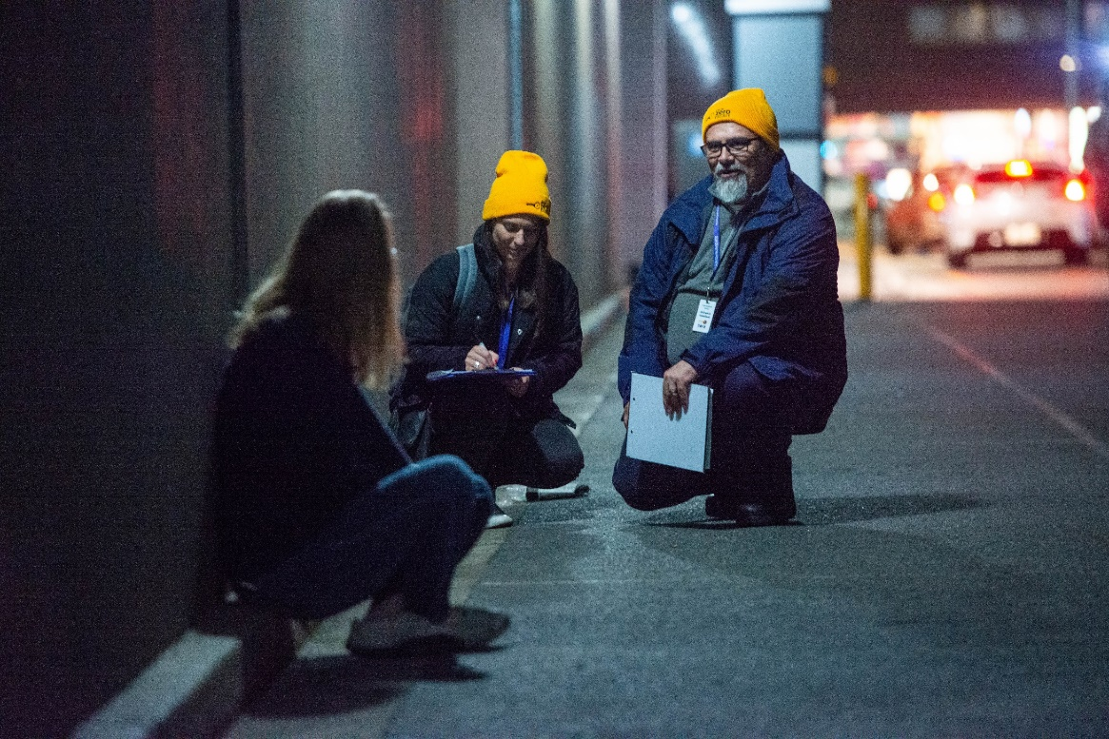
Collaboration and Homelessness
Lessons from the Adelaide Zero Project

Slide 2









1) Realise the benefits of cross sectoral collaboration

Slide 3
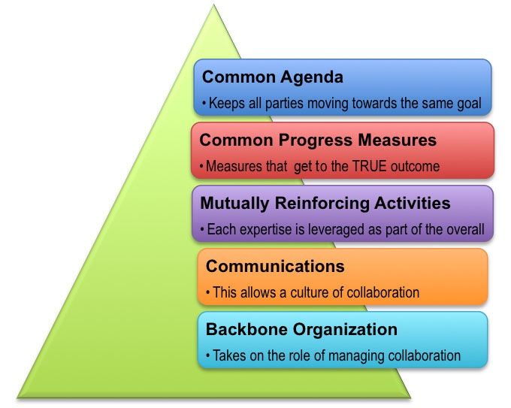
2) Complexity requires collaboration
3) Kill ‘em with kindness
4) Remember collaboration is just a tool
5) Inspired by Collective Impact Approach
6) Trust is a must
7) Share Credit
8) Think Global, Act Local
Source: Collaboration for Impact, 2018

Slide 4
8) Collaboration is hard but crucial
“True collaboration depends on the quality of our culture. And this depends on the quality of our relationships which in turn depend on the quality of our conversations… it all starts with better conversations” - Unknown

